Slide 1
NLP Final Project: Sentiment Analysis of Public Opinion
Presented by:
Georgi Stoyanov, Slav Yolov, Lyuben Zarev

Slide 2
Project analysis slide 2
Project Overview
Data Understanding
Data Preparation
NLP PROJECT
Evaluation of Results
Selection of Algorithms
Sentiment Analysis
Cross Annotation

Slide 3
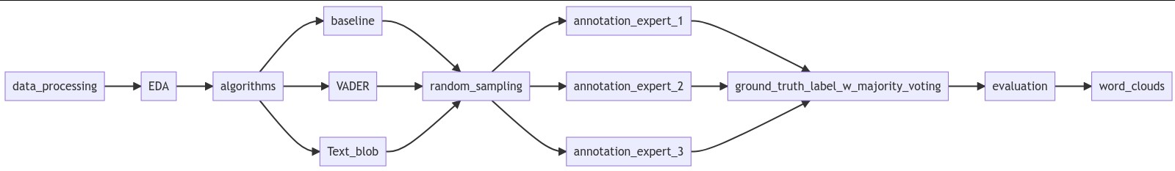
Project analysis slide 4
Methodology

Slide 4
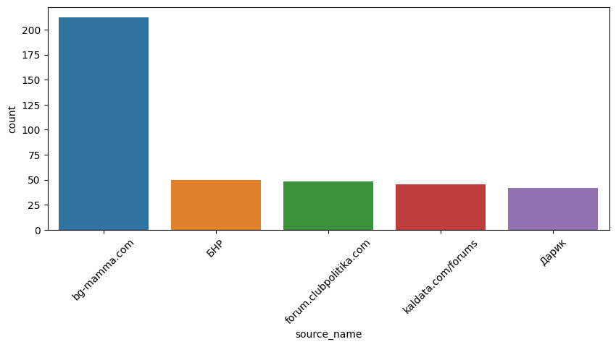
Project analysis slide 5
Data Sources
Forums
Blogs
Radio
Video sites
501
165
92
2

Slide 5
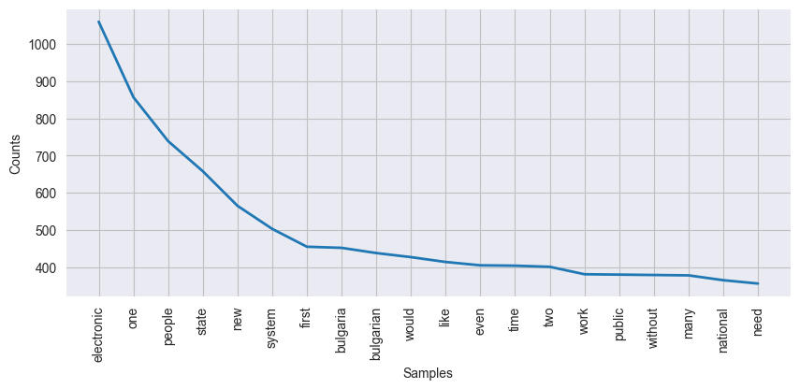
Project analysis slide 5
Words Frequency
Analyzed records
Used between
760
1,100 and 500

Slide 6

Project analysis slide 6
Chosen Algorithms
The aim of this model is to assign a basic, inaccurate prediction. Then, beat this model with more advanced algorithms.
Valence Aware Dictionary and sEntiment Reasoner uses a lexicon of sentiment-related words to determine the overall sentiment of a given body of text.
Python library for processing common NLP tasks.
This method calculates the polarity [-1, 1] of textual data.
Baseline
VADER

Slide 7
Project analysis slide 4
Cross Annotation
Management Objectives
POSITIVE
Results are aggregated by majority voting.
Random Sample of 75 Records
Result:
POSITIVE
Target value for each record
NEUTRAL
Each (human) team member marks the records with either positive, negative or neutral annotation.
These target values are used to evaluate which algorithm completed the task most accurately.
POSITIVE

Slide 8
Project analysis slide 10
Results Summary
From all polarity predictions a sample of 75 cases is selected. The three algorithms are compared using the macro f1-score:
baseline : 0.28
VADER : 0.49
text_blob : 0.3
Although f1-scores are relatively low, VADER is able to outperform the other approaches.
TextBlob is mostly predicting neutral values and it seems it is not able to distinguish between positive and negative.

Slide 9
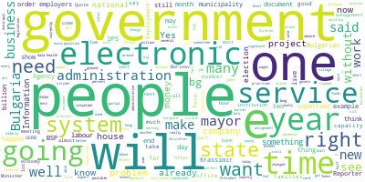
Project analysis slide 6
Guess the sentiment!
Negative

Slide 10
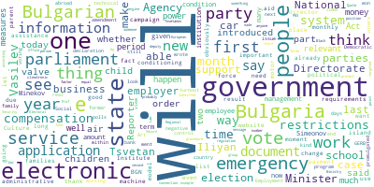
Project analysis slide 6
Guess the sentiment!
Neutral

Slide 11
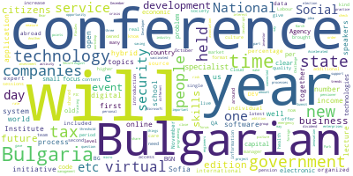
Project analysis slide 6
Guess the sentiment!
Positive

Slide 12


Project analysis slide 6
Conclusion
Questions?
VADER outperforms the rest of the algorithms
Results
Future?
VADER
Studies like this can support the work of the government and administrators, improving the modernization and implementation of e-gov systems.
Future developments can:
Expand data set by adding sentiments from social media.
Employ more advanced NLP methods (topic modeling).
Explore the usage of advanced ML.

Slide 13
Thank You
Sofia University, Faculty of Economics and Business Administration
January 2023

